Slide 1
SQL Join

Slide 2
Outline
Introduction
INNER JOIN
LEFT JOIN
RIGHT JOIN

Slide 3
SQL Join
A JOIN clause is used to combine rows from two or more tables, based on a common key values between them.

Slide 4




SQL Join

Slide 5

transactions
transaction_id | amount | customer_id
1000 | 4.99 | 3
1001 | 2.89 | 2
1002 | 3.38 | 3
1003 | 4.99 | 1
1004 | 1.00 | null
customers
customer_id | first_name | last_name
1 | Elizer | Ponio
2 | Juan | Dela Cruz
3 | Miguel | Reyes
4 | Rona | Salazar
For example, if we need to retrieve all transactions made showing the amount and the name of the customer, we need to retrieve columns from two different tables.

Slide 6
transactions
transaction_id | amount | customer_id
1000 | 4.99 | 3
1001 | 2.89 | 2
1002 | 3.38 | 3
1003 | 4.99 | 1
1004 | 1.00 | null
customers
customer_id | first_name | last_name
1 | Elizer | Ponio
2 | Juan | Dela Cruz
3 | Miguel | Reyes
4 | Rona | Salazar
In order to do this, we need to join the results of two tables.

Slide 7
transactions
transaction_id | amount | customer_id
1000 | 4.99 | 3
1001 | 2.89 | 2
1002 | 3.38 | 3
1003 | 4.99 | 1
1004 | 1.00 | null
customers
customer_id | first_name | last_name
1 | Elizer | Ponio
2 | Juan | Dela Cruz
3 | Miguel | Reyes
4 | Rona | Salazar
INNER JOIN will let us display what is common between two tables.
To use INNER JOIN, there must be matching values in both tables.

Slide 8
transactions
transaction_id | amount | customer_id
1000 | 4.99 | 3
1001 | 2.89 | 2
1002 | 3.38 | 3
1003 | 4.99 | 1
1004 | 1.00 | null
customers
customer_id | first_name | last_name
1 | Elizer | Ponio
2 | Juan | Dela Cruz
3 | Miguel | Reyes
4 | Rona | Salazar
In this example, both tables are related to each other through the customer_id column.
We will join the transactions table with the customers table, by using the customer_id field from both tables

Slide 9
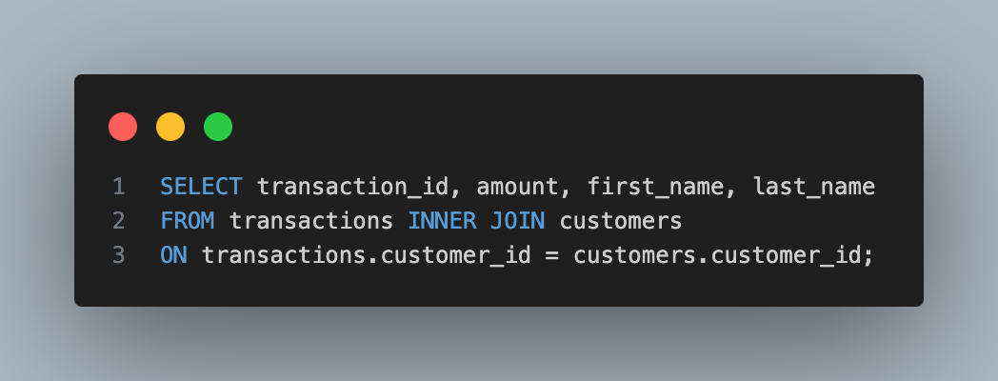

Slide 10




transactions
transaction_id | amount | customer_id
1000 | 4.99 | 3
1001 | 2.89 | 2
1002 | 3.38 | 3
1003 | 4.99 | 1
1004 | 1.00 | null
customers
customer_id | first_name | last_name
1 | Elizer | Ponio
2 | Juan | Dela Cruz
3 | Miguel | Reyes
4 | Rona | Salazar
null

Slide 11
transactions
transaction_id | amount | customer_id
1000 | 4.99 | 3
1001 | 2.89 | 2
1002 | 3.38 | 3
1003 | 4.99 | 1
1004 | 1.00 | null
customers
customer_id | first_name | last_name
1 | Elizer | Ponio
2 | Juan | Dela Cruz
3 | Miguel | Reyes
4 | Rona | Salazar
null

Slide 12
transactions
transaction_id | amount | customer_id
1000 | 4.99 | 3
1001 | 2.89 | 2
1002 | 3.38 | 3
1003 | 4.99 | 1
1004 | 1.00
customers
customer_id | first_name | last_name
1 | Elizer | Ponio
2 | Juan | Dela Cruz
3 | Miguel | Reyes
4 | Rona | Salazar
Result:
transaction_id | amount | first_name | last_name
1000 | 4.99 | Miguel | Reyes
1001 | 2.89 | Juan | Dela Cruz
1002 | 3.38 | Miguel | Reyes
1003 | 4.99 | Elizer | Ponio

Slide 13
LEFT Join
Shows the full left table but the only the common items from the right table.

Slide 14
transactions
transaction_id | amount | customer_id
1000 | 4.99 | 3
1001 | 2.89 | 2
1002 | 3.38 | 3
1003 | 4.99 | 1
1004 | 1.00 | null
customers
customer_id | first_name | last_name
1 | Elizer | Ponio
2 | Juan | Dela Cruz
3 | Miguel | Reyes
4 | Rona | Salazar
null

Slide 15
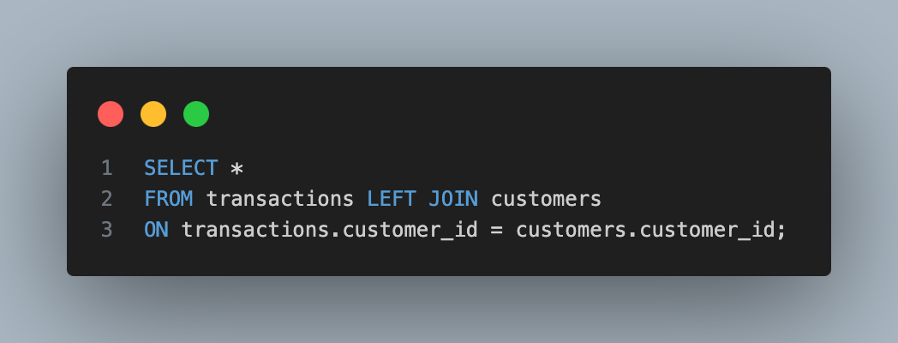

Slide 16
transactions
transaction_id | amount | customer_id
1000 | 4.99 | 3
1001 | 2.89 | 2
1002 | 3.38 | 3
1003 | 4.99 | 1
1004 | 1.00 | null
customers
customer_id | first_name | last_name
1 | Elizer | Ponio
2 | Juan | Dela Cruz
3 | Miguel | Reyes
4 | Rona | Salazar
Result:
transaction_id | amount | first_name | last_name
1000 | 4.99 | Miguel | Reyes
1001 | 2.89 | Juan | Dela Cruz
1002 | 3.38 | Miguel | Reyes
1003 | 4.99 | Elizer | Ponio
1004 | 1.00 | null | null

Slide 17
RIGHT Join
Shows the full right table but the only the common items from the left table

Slide 18
transactions
transaction_id | amount | customer_id
1000 | 4.99 | 3
1001 | 2.89 | 2
1002 | 3.38 | 3
1003 | 4.99 | 1
1004 | 1.00 | null
customers
customer_id | first_name | last_name
1 | Elizer | Ponio
2 | Juan | Dela Cruz
3 | Miguel | Reyes
4 | Rona | Salazar
null

Slide 19
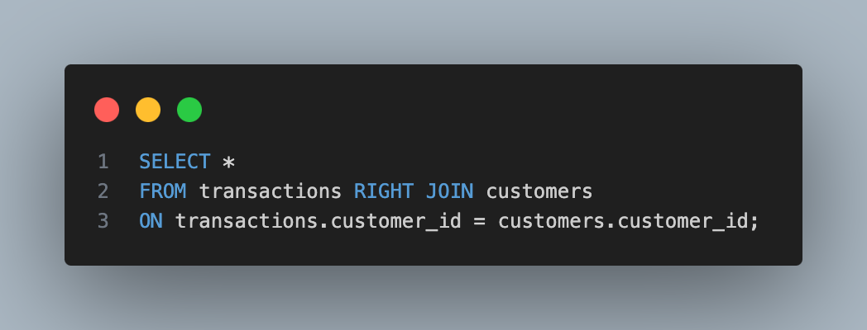

Slide 20
transactions
transaction_id | amount | customer_id
1000 | 4.99 | 3
1001 | 2.89 | 2
1002 | 3.38 | 3
1003 | 4.99 | 1
1004 | 1.00 | null
customers
customer_id | first_name | last_name
1 | Elizer | Ponio
2 | Juan | Dela Cruz
3 | Miguel | Reyes
4 | Rona | Salazar
Result:
transaction_id | amount | first_name | last_name
1000 | 4.99 | Miguel | Reyes
1001 | 2.89 | Juan | Dela Cruz
1002 | 3.38 | Miguel | Reyes
1003 | 4.99 | Elizer | Ponio
null | null | Rona | Salazar

